Slide 1
MATH 5110 – Applied Linear Algebra and Matrix Analysis
Introduction
Instructor: He Wang
Department of Mathematics
Northeastern University
https://hewang.sites.northeastern.edu/

Slide 2
MATH 5110 Overview:
This course provides a rigorous treatment of the concepts and computational techniques of linear algebra.
The major goal is to master the fundamental theory and techniques that underlie the applications of linear algebra in computer science, statistics, engineering, etc.
Another goal is to provide a solid foundation for studying other subjects later.
The course is designed for graduate students in Applied Mathematics, Computer Science, Engineering, and students who wish to obtain deeper insights beyond an undergraduate level linear algebra.

Slide 3
Quick Questions:
1. Quick self-introduction.
2. What is your academic background? (Major in BS and MS)
3. What is your linear algebra/math background?
4. What do you expect from this course?
5. What is your career plan?

Slide 4
Q: What is linear algebra?
ChatGPT:
https://chat.openai.com/
Wikipedia:
https://en.wikipedia.org/wiki/Linear_algebra
Linear algebra is a branch of mathematics that deals with vector spaces and linear transformations between them.
Linear algebra forms the foundation for many/all areas of mathematics, as well as numerous applications in various fields such as physics, computer science, engineering, economics, and data analysis.
Linear algebra extends to more advanced topics such as multilinear algebra, tensor algebra, and matrix calculus. Multilinear algebra deals with objects beyond vectors and matrices, such as tensors, which are higher-dimensional arrays. Matrix calculus involves differentiating functions that involve matrices and vectors, enabling optimization and solving problems in fields like machine learning, signal processing, and control theory.

Slide 5
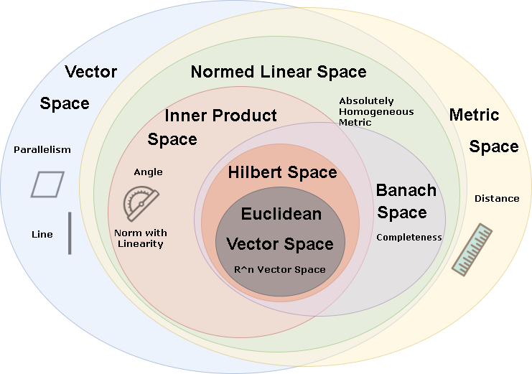
Spaces
https://misa-xu.github.io/space/

Slide 6
Q: What is Matrix Analysis?
ChatGPT:
https://chat.openai.com/
Wikipedia:
https://en.wikipedia.org/wiki/Matrix_analysis
Matrix analysis is a branch of mathematics that focuses on the properties, operations, and applications of matrices.
Matrix analysis finds applications in diverse fields, including numerical analysis, linear programming, optimization, control theory, signal processing, quantum mechanics, and network analysis.
Key concepts and techniques in matrix analysis include: Eigenvalues and Eigenvectors; Matrix Factorizations; Matrix Norms; Matrix Inequalities; Matrix Functions, etc.

Slide 7
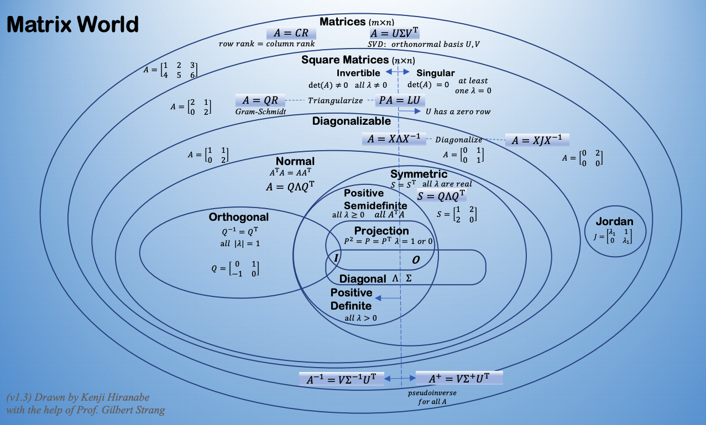
Matrices
Notes:
https://web.stanford.edu/~boyd/vmls/vmls.pdf

Slide 8
List of main topics:
Linear system, matrix algebra: Linear systems and matrix equations; row reduced echelon form; existence and uniqueness of solutions; matrix operations including sum, scalar product, matrix product, inverse, transpose.
Linear spaces over a field: linear vector spaces; subspaces; spanning sets, independence, nullspace of matrix; basis and dimension; coordinate; rank-nullity theorem; linear transformations; change of basis; chain complex and homology.

Slide 9
3. Jordan normal forms: determinant; eigenvalues and eigenvectors; eigenbasis; eigenspaces; algebraic and geometric multiplicity; solution of iterated linear system; singularity, invertibility, rank etc; similarity; diagonalization; powers of a matrix; Jordan normal form and the Cayley Hamilton Theorem.
Applications to Discrete dynamical systems: positive systems; Perron-Frobenius Theorem; stochastic matrix; Markov chain.
4. Inner product spaces: Inner product, norm, Cauchy-Schwarz inequality; orthogonal projection onto subspace; orthogonal basis; Gram-Schmidt process; symmetric matrix, diagonalization; positive definite; variational formulas for eigenvalues, Singular value decomposition (SVD) and data compression.
Applications of SVD and pseudo-inverses to principal component analysis (PCA) for data analysis, optimal orthogonal projections, principal components, PCA in Statistics, covariance matrix, optimal linear combinations of random variables, principal components, interpretation.

Slide 10
Extra topics (as time allows for lecture, or for the final project):
Matrix factorization, including Jordan, Schur, LU, QR, SVD;
Fourier Transform and FFT
Haar bases and the corresponding Haar wavelets.
Hadamard matrices.
Affine space and affine maps
Norms and matrix norms
Convergence of sequences and series in a normed vector space. The matrix exponential $e^{A}$ and its basic properties.
The group of unit quaternions, SU(2), and the representation of rotations in SO(3) by unit quaternions
An introduction to algebraic and spectral graph theory.
Methods for computing eigenvalues and eigenvectors, with a main focus on the QR algorithm
The geometry of the orthogonal groups O(n) and SO(n), and of the unitary groups U(n) and SU(n).
Duality norm and dual norms
Linear Programing (optimizaiton)
Calculus for matrix-valued functions;
Neural networks and back propagation equation;
Exterior algebra and tensor algebra
Multilinear Algebra
Notes:
https://math.mit.edu/classes/18.952/spring2013/docs/book.pdf
https://www2.math.ethz.ch/education/bachelor/lectures/fs2016/other/mla/ma.pdf

Slide 11
Computer lab topics:
Solving Linear Equations
Recover matrix from data
Change of coordinates for circular orbit
Area and determinant
Discrete Dynamical Systems
Least Squares Data Fitting
FFT
Digital Image Compression (SVD)
etc.
Final Project:
Extra topics

Slide 12
Linear Algebra Knowledge Overview:
Linear system
Matrix “algebra”
Vector spaces (sum, scalar product),
Linear transformation
More operations (Row operations, LU-factorizations, trace ,determinant, rank)
Basis, coordinate and dimension
Eigenvalue and Eigenspaces
Diagonalization, Jordan Canonical Form
Applications: Perron-Frobenius Theorem, Markov chain, dynamical system, Google’s Page-Rank Algorithm

Slide 13
Inner Product Space (sum, scalar product, inner product) Geometry
Orthogonal Projection, Orthogonal Basis
Gram-Schmidt process, QR factorization
Spectral Decomposition
General Least-Squares
SVD, PCA
FFT

Slide 14
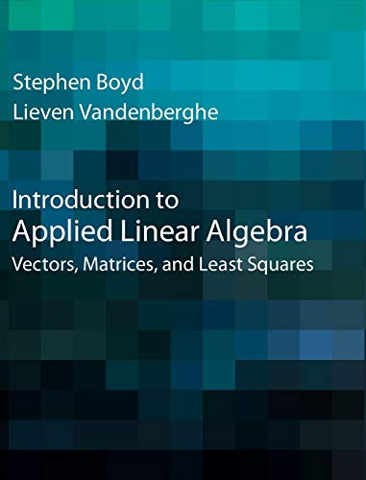
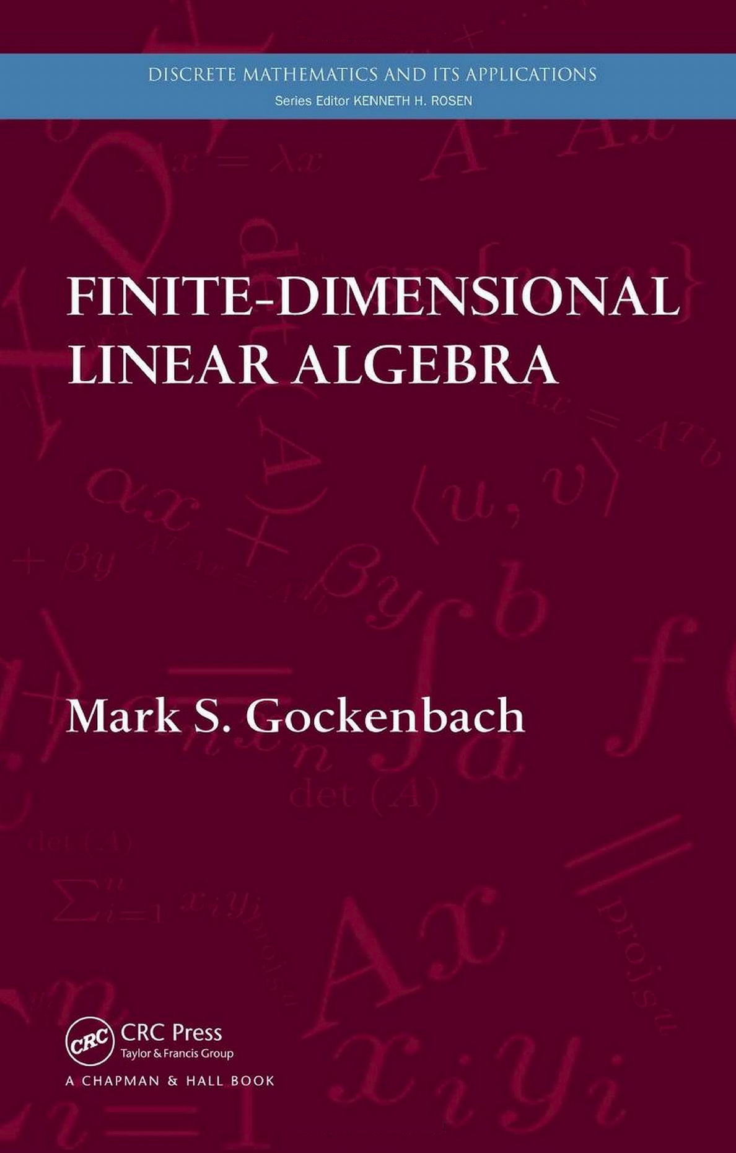
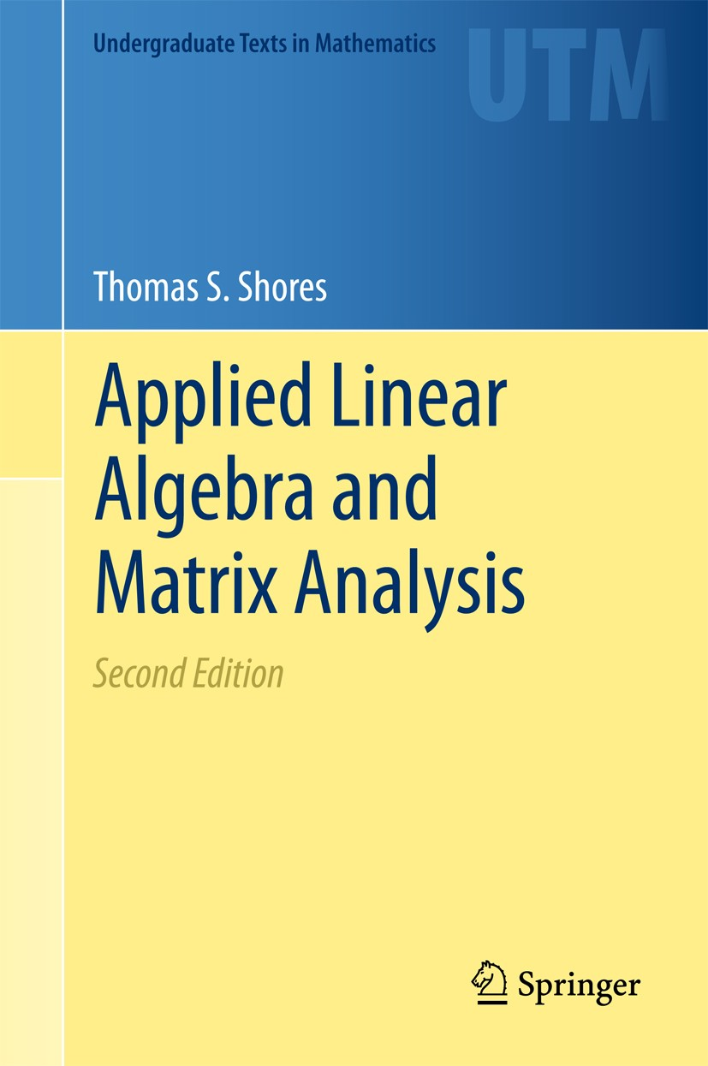
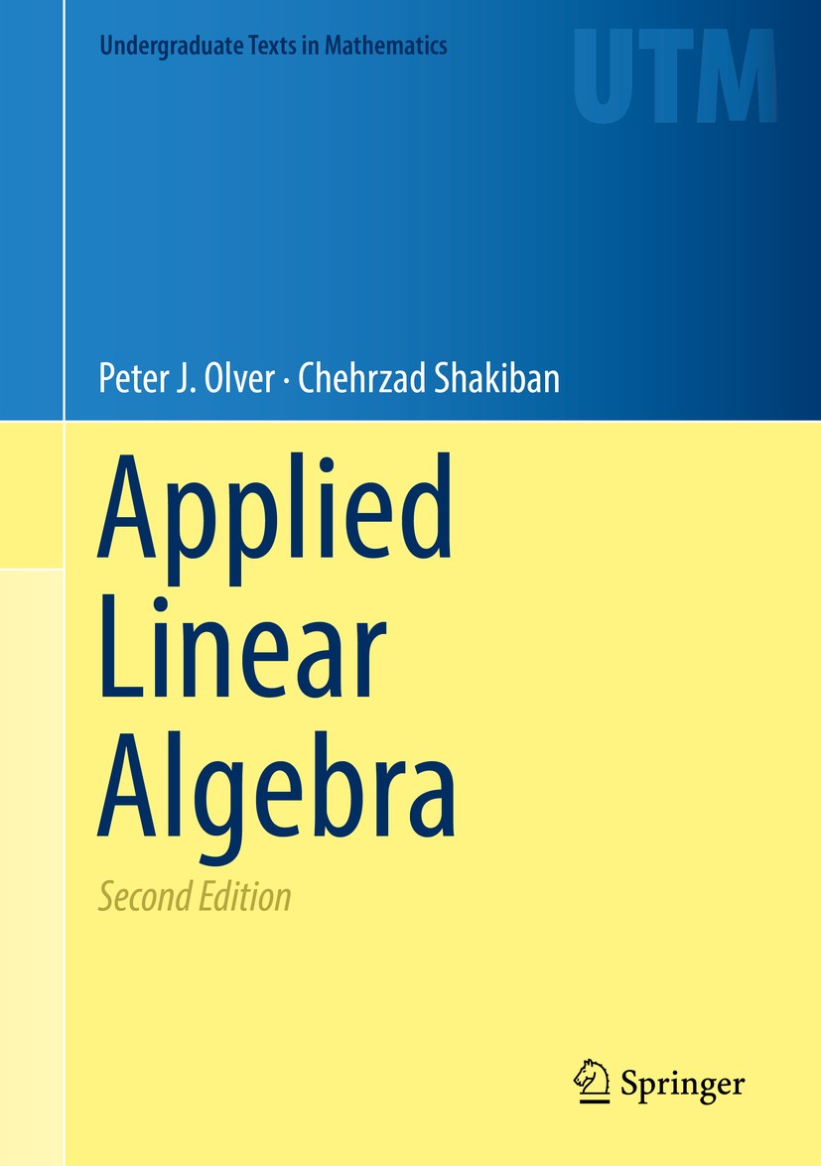
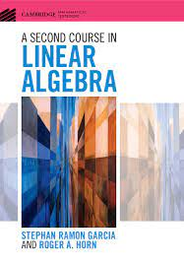
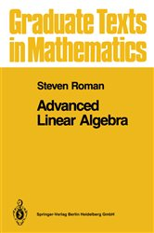
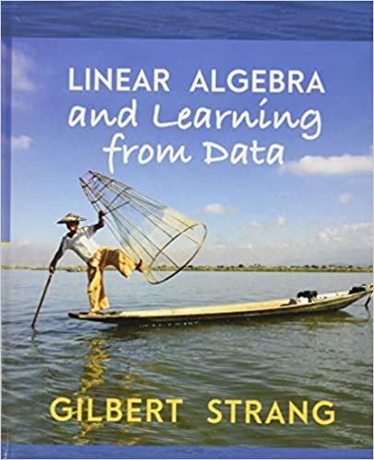
Reference:
Finite-dimensional linear algebra, Mark S. Gockenbach, CRC Press.
Linear Algebra and learning from data, Gilbert Strang, Wellesley-Cambridge Press
Applied Linear Algebra and Matrix Analysis, Shores, Thomas S., Springer
Applied Linear Algebra, Olver, Peter J., Shakiban, Chehrzad, Springer
A Second Course in Linear Algebra, S. R. Garcia, R. A. Horn, Cambridge University Press
Matrix Analysis and Applied Linear Algebra, C. D. Meyer, SIAM, 2000.
Advanced Linear algebra, Steven Roman, GTM, Springer 3rd edition
Introduction to Applied Linear Algebra Vectors, Matrices, and Least Squares
https://web.stanford.edu/~boyd/vmls/vmls.pdf

Slide 15
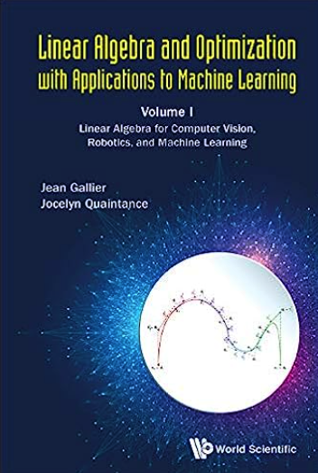
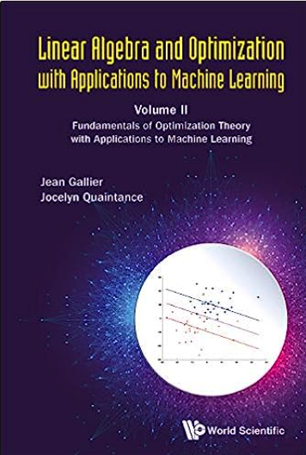
Linear Algebra and Optimization with Applications to Machine Learning:
Volume I: Linear Algebra for Computer Vision, Robotics, and Machine Learning
Volume II: Fundamentals of Optimization Theory with Applications to Machine Learning
by Jean Gallier and Jocelyn Quaintance
https://www.cis.upenn.edu/~jean/gbooks/linalg.html
Algebra, Topology, Differential Calculus, and Optimization Theory for Computer Science and Machine Learning (2192 pages)
https://www.cis.upenn.edu/~jean/gbooks/geomath.html

Slide 16
More references for linear algebra, probability and machine learning:
https://docs.google.com/spreadsheets/d/1j8LcyTxBTZ5Nh0-P1rb6NT2x_2iXFp1j8ptpvHYQWGA/edit#gid=0
https://misa-xu.github.io/space/
https://people.bath.ac.uk/mw2319/ma30252/ch-fund.html
https://terrytao.wordpress.com/2019/08/13/eigenvectors-from-eigenvalues/

Slide 17
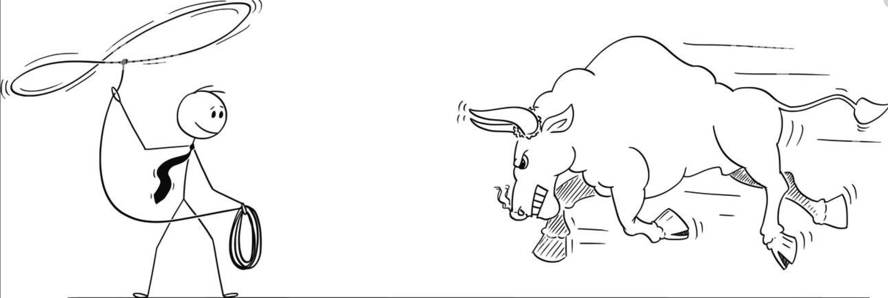
Joke:
Machine Learning will be baffled by a strange jargon involving exotic terms such as kernel PCA, ridge regression, lasso regression, support vector machines (SVM), Lagrange multipliers, KKT conditions, etc.
Q: Do support vector machines chase cattle to catch them with some kind of super lasso?
A: No. behind the jargon which always comes with a new field (perhaps to keep the outsiders out of the club), lies a lot of “classical” linear algebra and techniques from optimization theory, (and probability theory and statistics)
Q/A from Jean Gallier
Image from alamy.com

